Slide 1
MEDITECH Expanse Universal Discharge
Web Based EHR

Slide 2
Content Only major sections indicated
Introduction
Universal Discharge InPt
Referrals
Prescriptions
ED Discharge
Slide 3
Slide 5
Slides 16-18
Slides 20-31
Slides 42-45

Slide 3
Universal Discharge Overview
Meditech has adopted a Discharge Process with all-inclusive access
Providers have the most input, but
Case Management and Nursing can add information
Registration details are included
While we will demonstrate the “discharge” tab
The same information is in discharge documents under the “Discharge Plan” section.

Slide 4
Universal Discharge Types
At the time this was produced, there were 3 different Universal Discharges
The location of the patient determines which displays
The current location each time “Discharge” is opened
ED (ED location)
ED specific information
Post-Op (SDS location)
Post-Op specific information
Everywhere Else
General information **This is what will be used for this training**

Slide 5
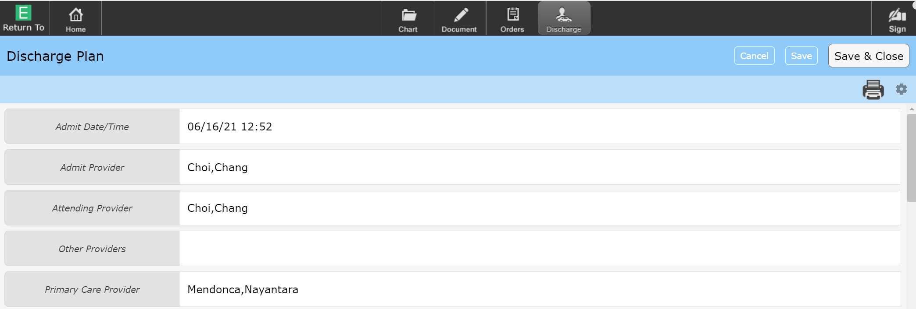
Universal Discharge
The Discharge screen
Registration information (grey indicates access to edit is restricted)
Option to Cancel or Save changes made
Save & Close (Saves and returns to the chart)

Slide 6
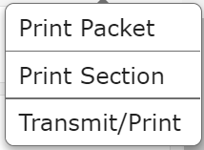
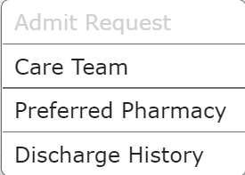
Universal Discharge
The Printer Icon
Print Packet & Print Sections – Nurses print the Discharge Packet usually
Transmit/Print – Reprint or Retransmit Prescriptions
Cogwheel
Care Team (All Providers associated with Account)
Preferred Pharmacy – Review/Edit Pharmacy to be used for eRx

Slide 7
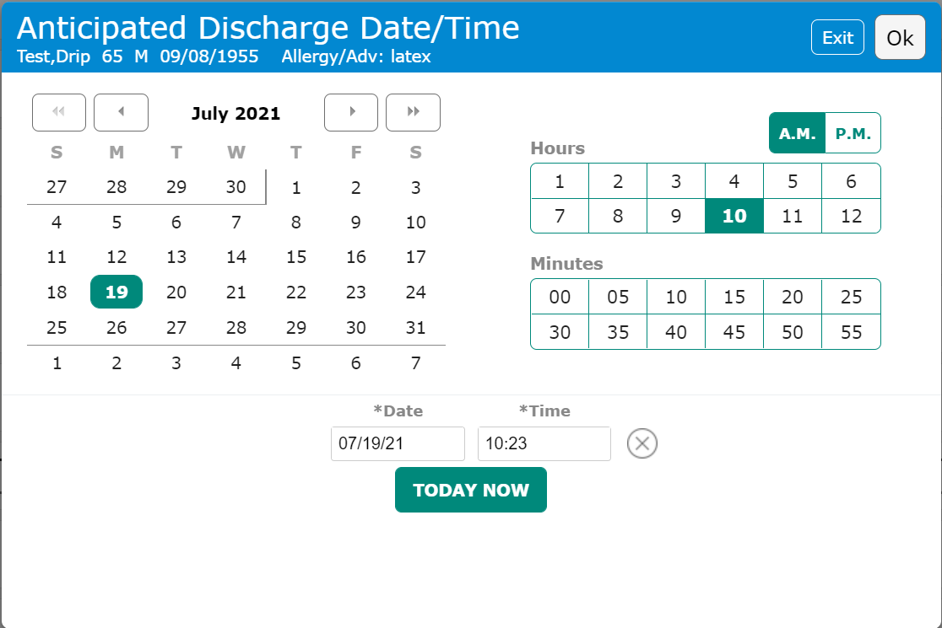
Universal Discharge Anticipated Discharge Date/Time
Anticipated Discharge Date/Time
Clicking anywhere within the highlighted are opens the Pop-Up
Click or type the Date and Time
Not a 24 clock so AM/PM must be selected
“Today Now” button if preparing for imminent discharge

Slide 8
Universal Discharge You were in the hospital because:
You were in the hospital because:
Free text
No ICD-10 codes included in Discharge Packet
Enter reason in layman’s terms

Slide 9
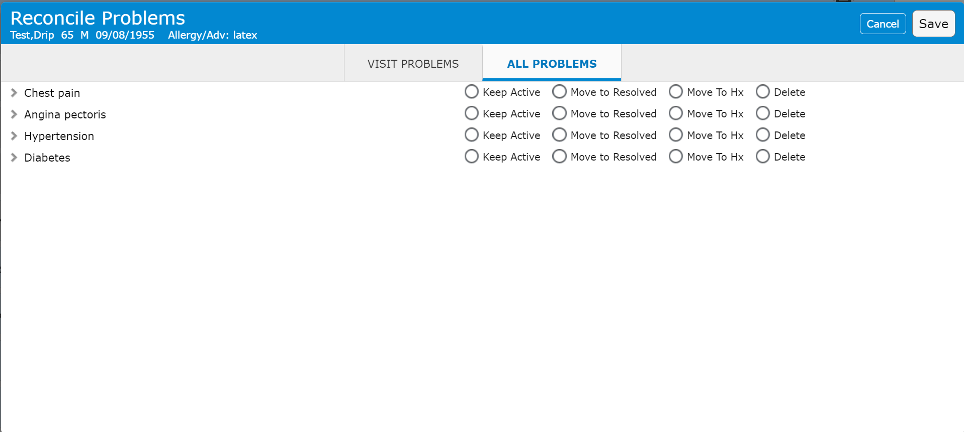
Universal Discharge Reconcile Problems
Reconcile Problems
Clicking anywhere within the highlighted are opens the Pop-Up
Visit/All – Defaults to “Visit”, “All” displays all Active Problems
Keep Active – Keeps problem in Active column (only recurring & chronic)
Move to Resolved – Resolved, non-chronic problems
Move to Hx – Chronic problems
Delete - Errors

Slide 10
Universal Discharge Condition
Condition
Clicking anywhere within the highlighted are opens the Pop-Up
Select Discharge Condition

Slide 11
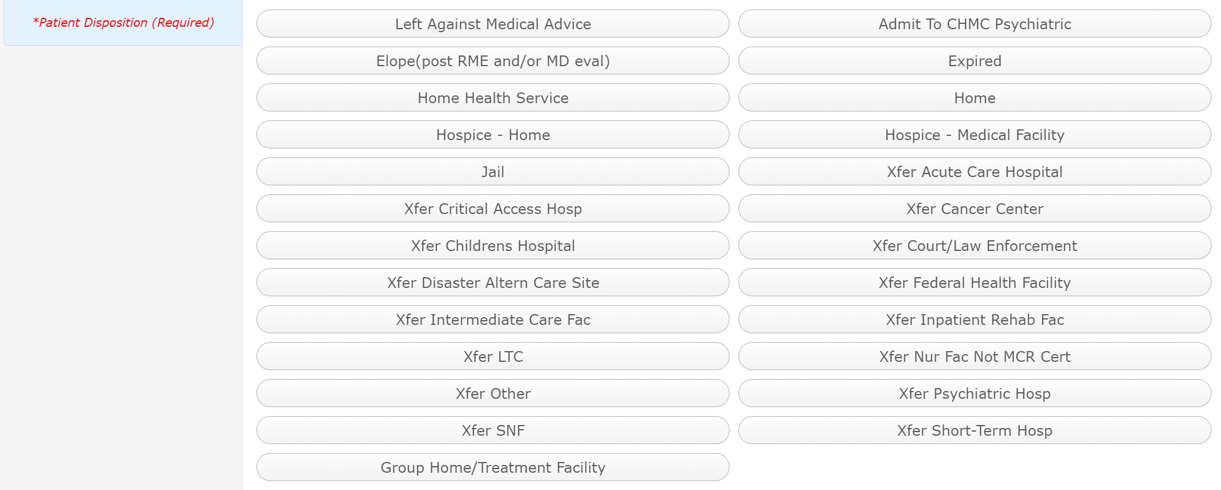
Universal Discharge *Patient Disposition
Patient Disposition
Clicking anywhere within the highlighted are opens the Pop-Up
Select appropriate disposition

Slide 12
Universal Discharge *Confirmed safe discharge with case manager
*Confirmed safe discharge with case manager
Select appropriate answer
This is a safety question to determine if you Case Management has been consulted with and agreed to the discharge
N/A – if it doesn’t apply
Patient Refuses Services – If patient is uncooperative with plan

Slide 13
Universal Discharge To facility
To facility
Free text
Nursing home or Rehabilitation facility
Not a transfer?

Slide 14
Universal Discharge Referrals
Referrals
Control who the patient will follow-up with
Click to Edit the PHP referral
Click to Add or Edit Referrals
Click to add yourself as Referral (Consultants)

Slide 15
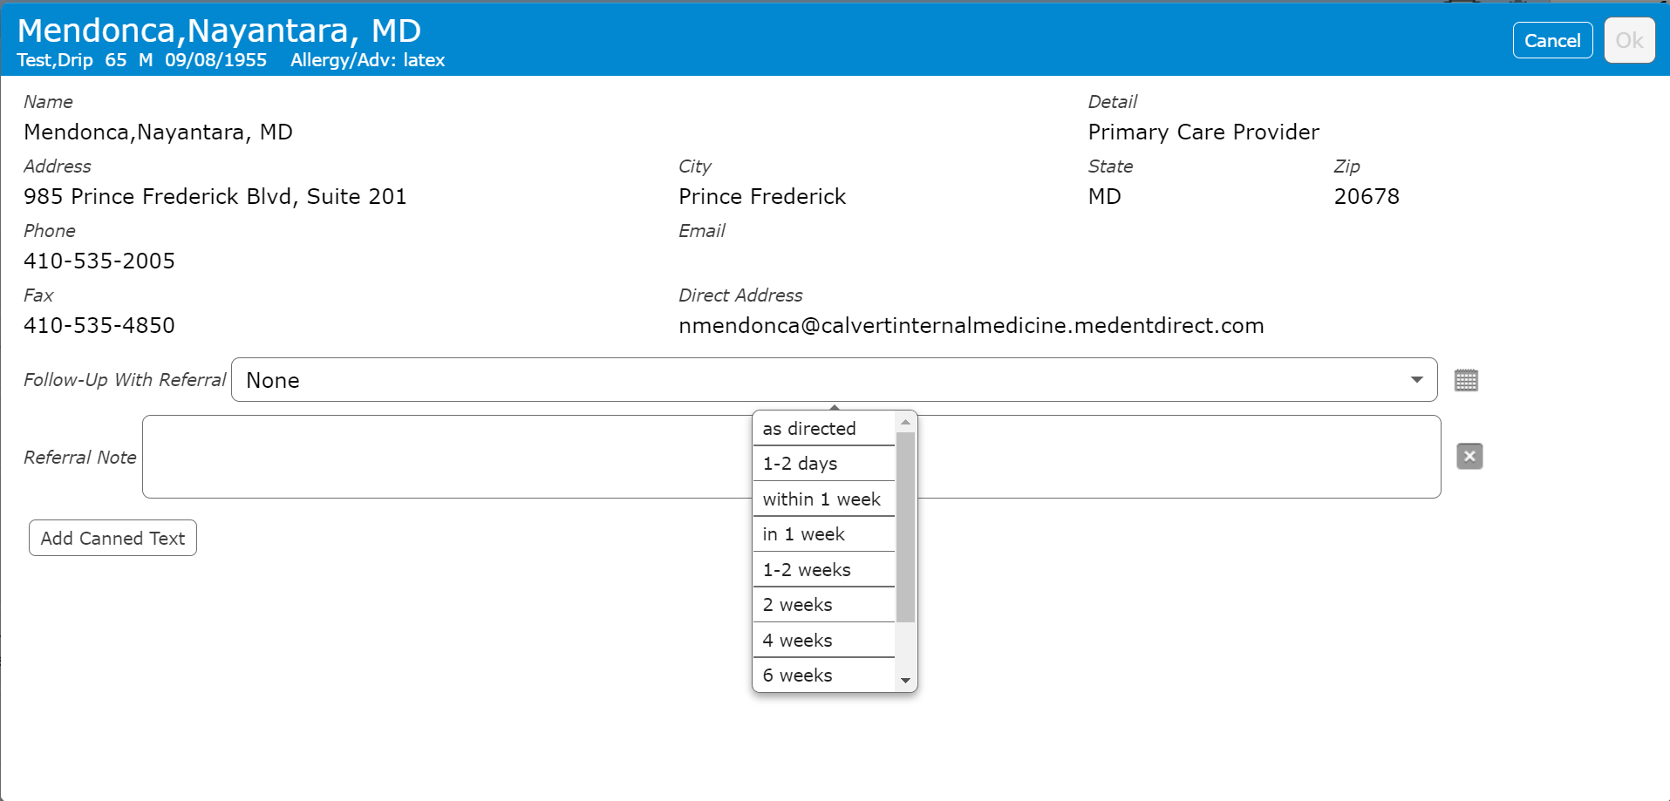
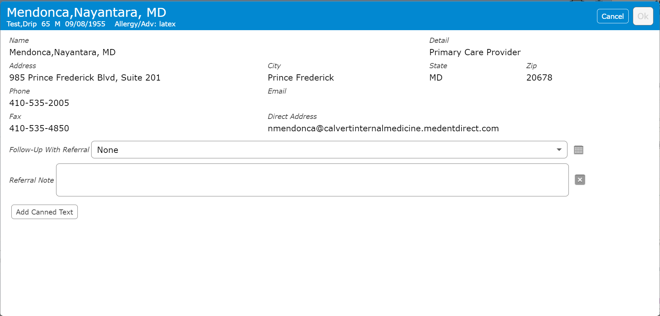
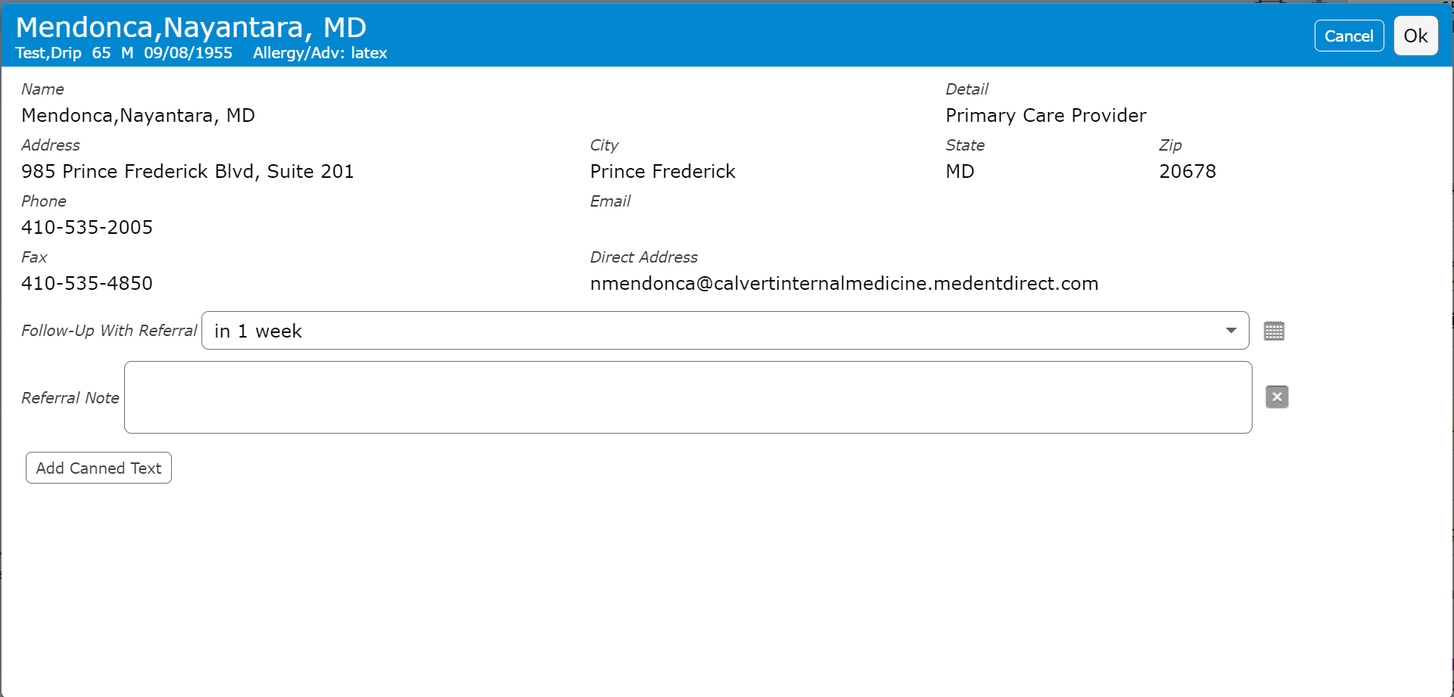
Universal Discharge Referrals
PHP Referral
Click to edit
Follow-Up time
Select time frame, or “As directed
Referral Note – Free text
Additional instructions

Slide 16
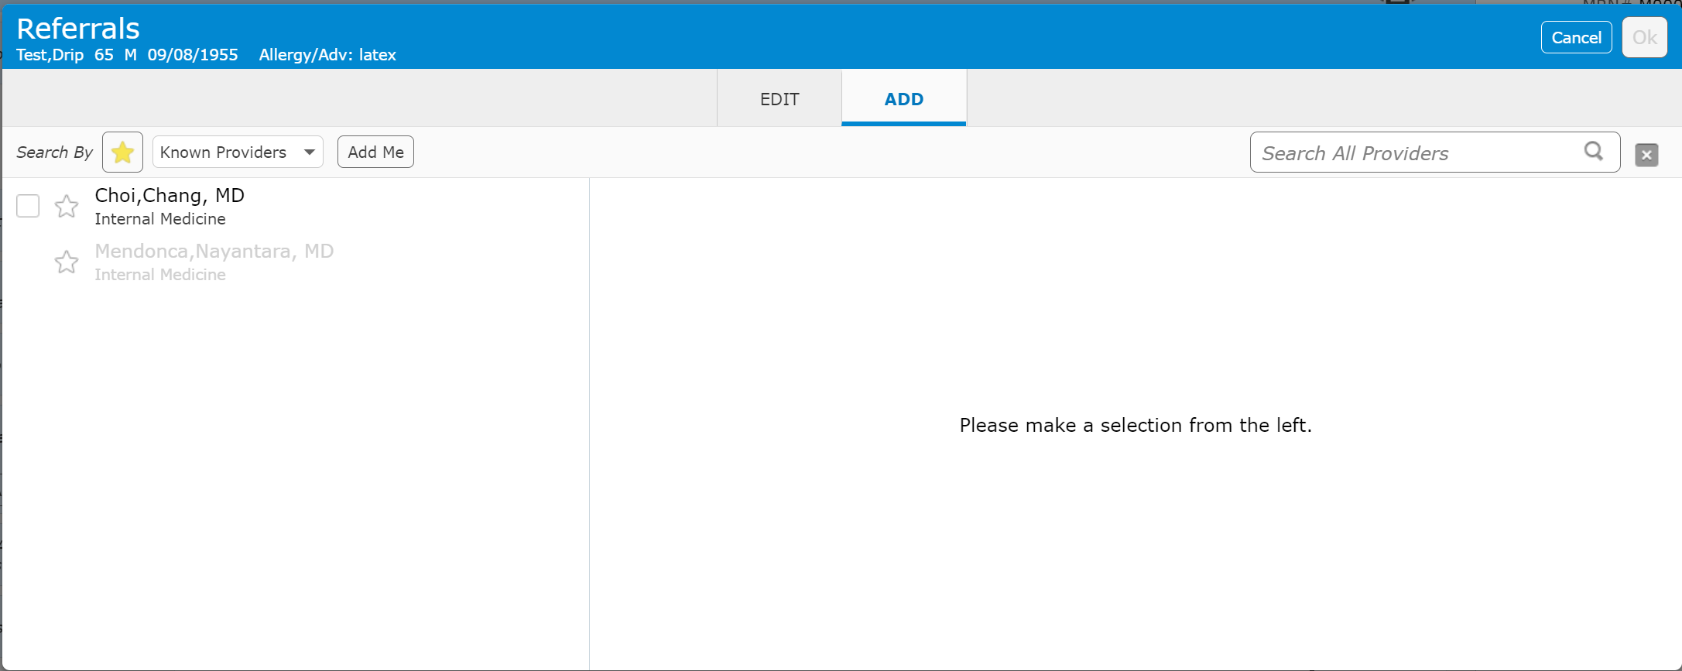
Universal Discharge Referrals
Referrals – Add Referral
Existing PHP and Admitting providers display (Also Favorites)
2nd “Add Me” button

Slide 17
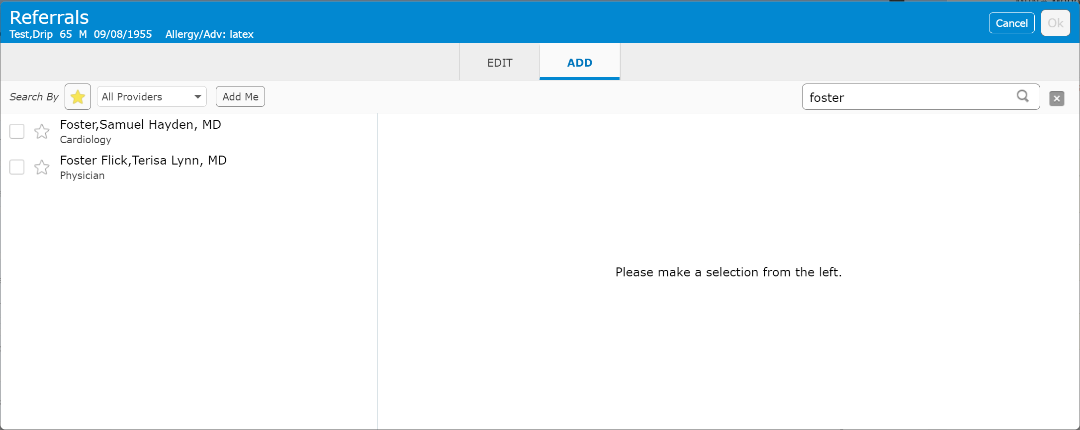
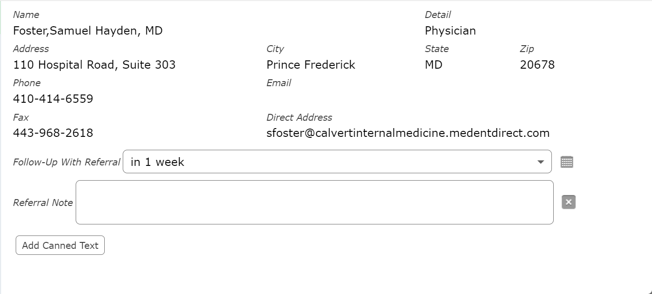
Universal Discharge Referrals
Searching for provider
Click on box to select (Add details as shown for PHP)
Click on star to save as a favorite

Slide 18
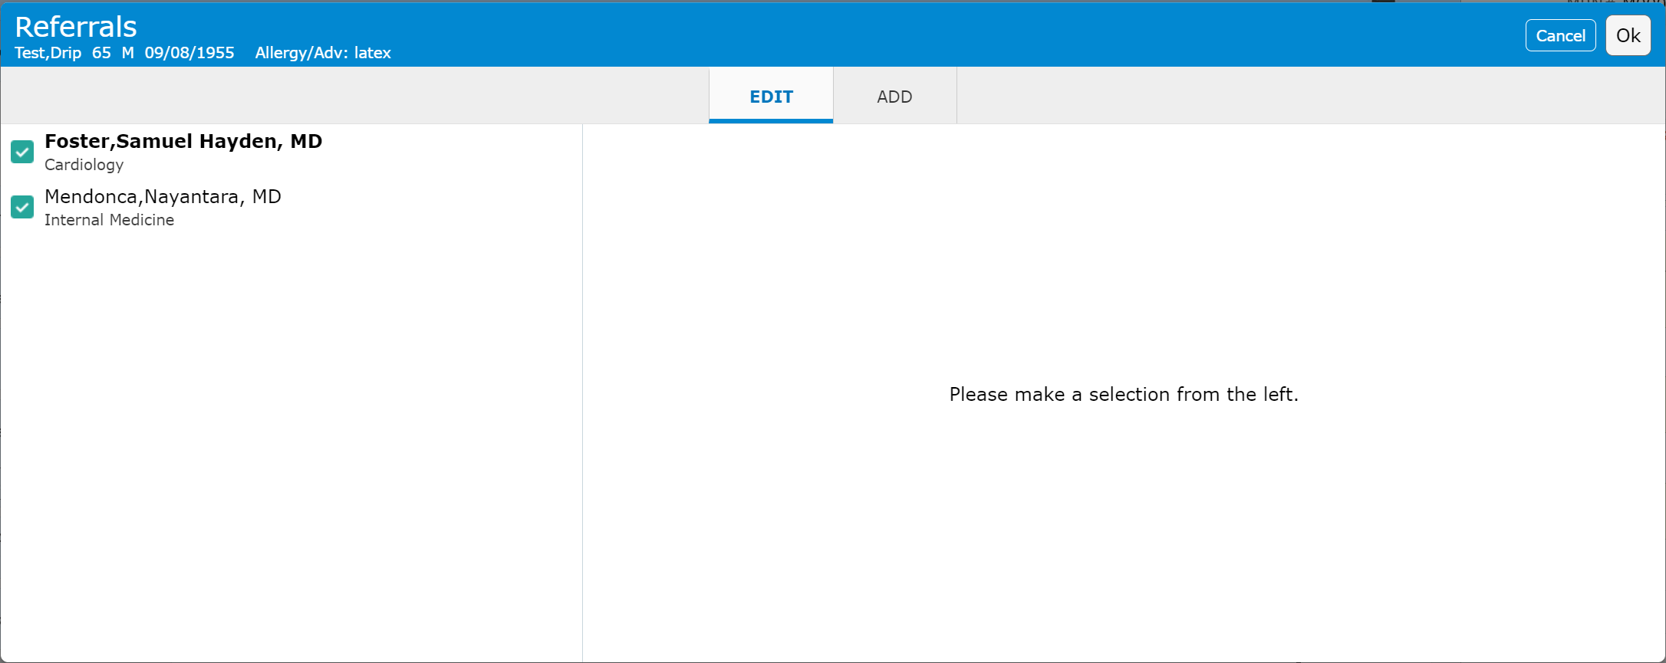
Universal Discharge Referrals
Edit Referrals
Click “Edit”
Click to uncheck box – Deselects referral

Slide 19
Universal Discharge Adfinitas Question
Adfinitas question
Hospitalist specific question
Ignore unless you are a hospitalist

Slide 20
Universal Discharge Prescriptions
Discharge Medication Reconciliation & Prescriptions
Click in either area to open Discharge Med Rec Screen

Slide 21
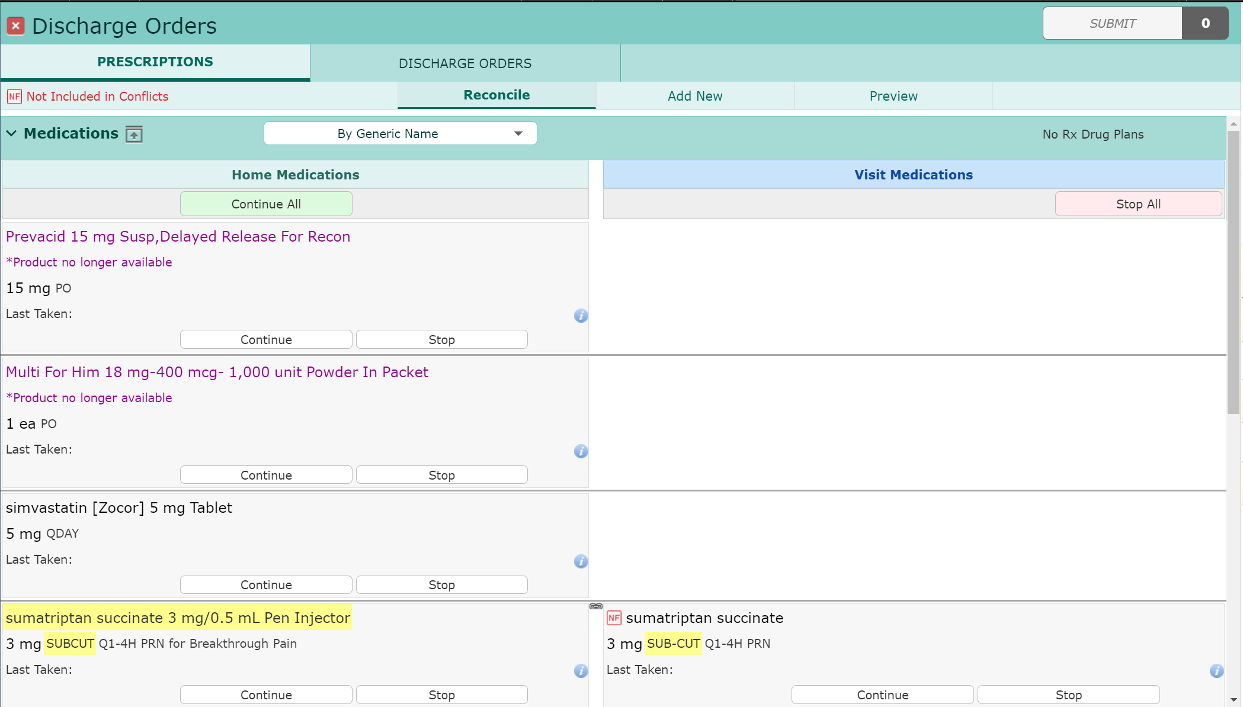
Universal Discharge Prescriptions
Home medications
Continue or Stop individual Meds
Continue All
Linked Medications
Will “Stop” on Visit Side automatically

Slide 22
Universal Discharge Prescriptions
Continued Home Medications
Click “Rx” symbol to create a prescription
i.e. patient is out of medication
Duration/QTY
Always enter QTY
PRN – Click to make prn (PRN reason required if selected)
RTE – Enter any additional required information (Route in this case)

Slide 23
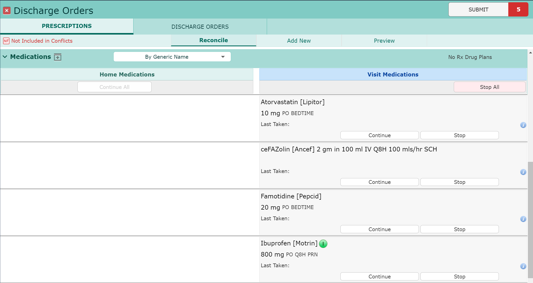
Universal Discharge Prescriptions
Visit Medications
Continue or Stop individual Meds
Stop All

Slide 24
Universal Discharge Prescriptions
Continuing a Visit Med
Converts to “New”
Becomes a Prescription
The same required and optional fields

Slide 25
Universal Discharge Prescriptions
New Prescriptions
Click “Add New”
Search for Rx Medication
Favorite medications display

Slide 26
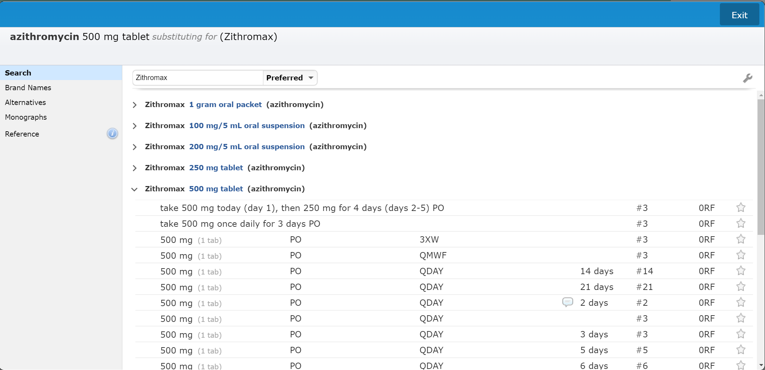
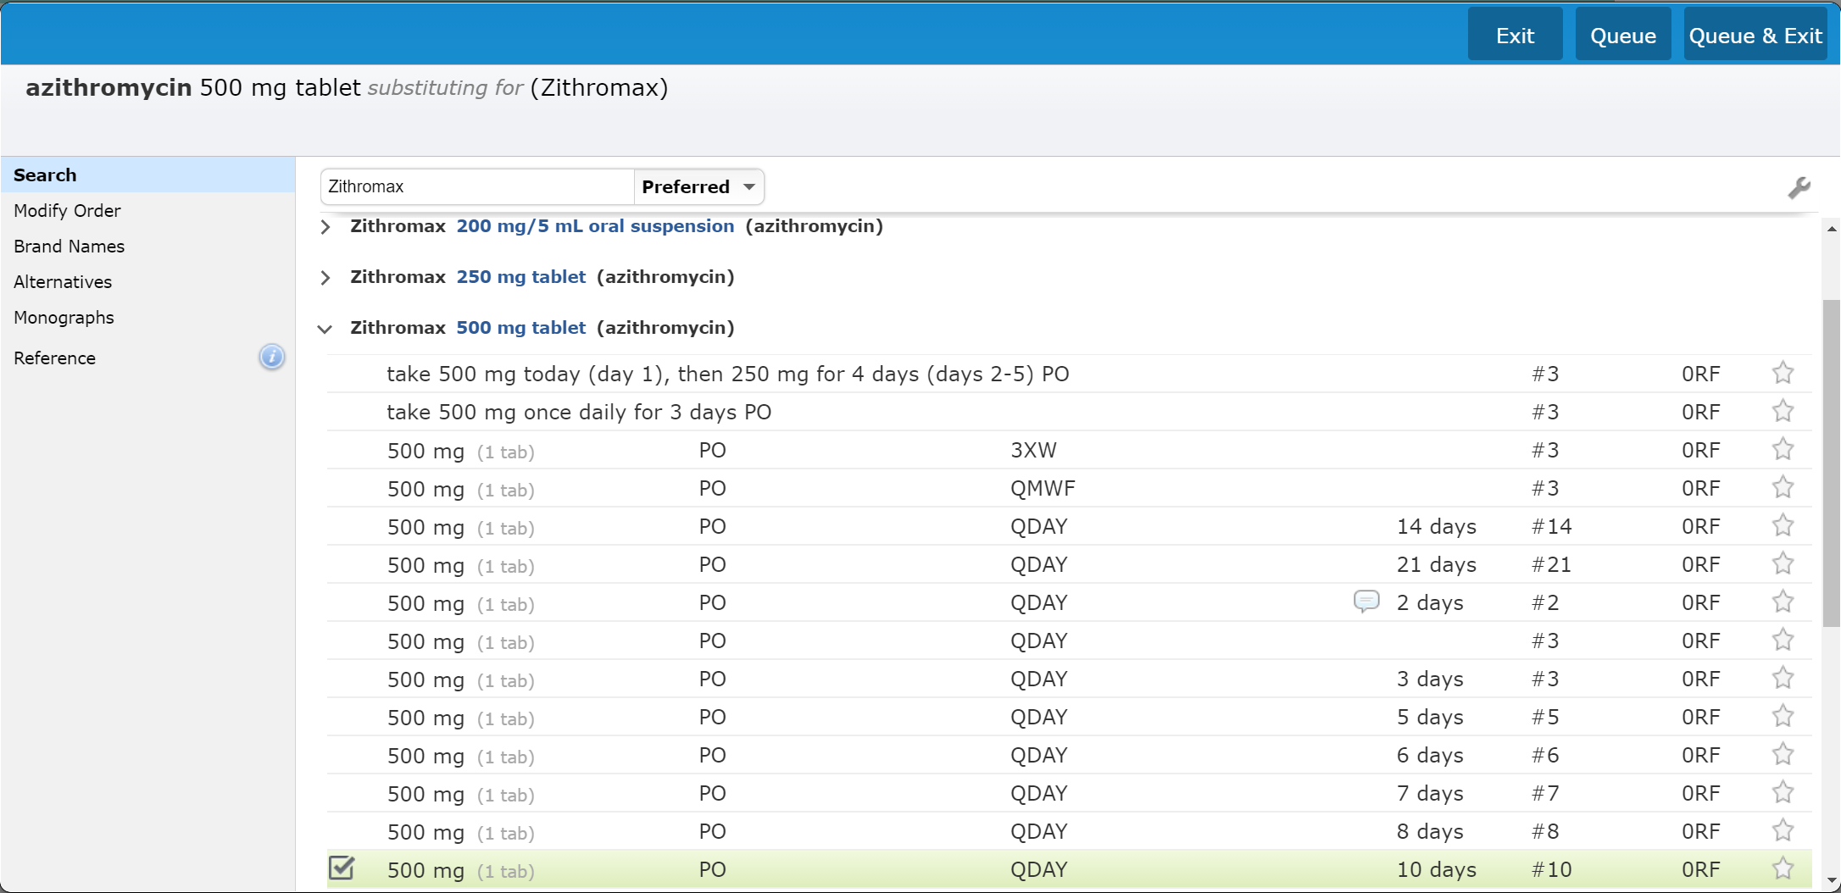
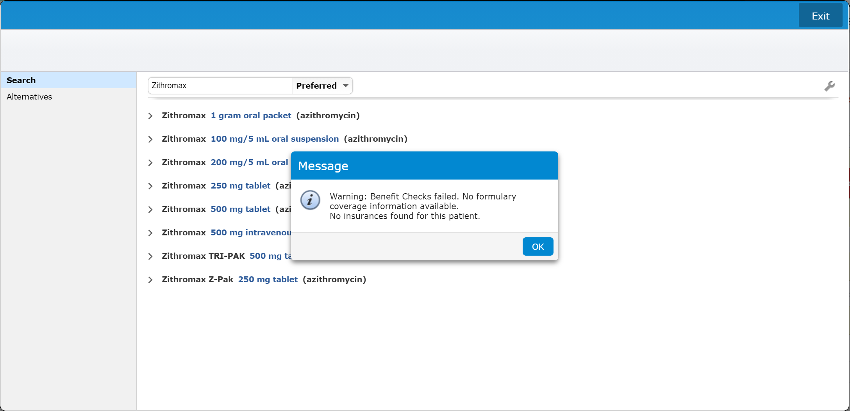
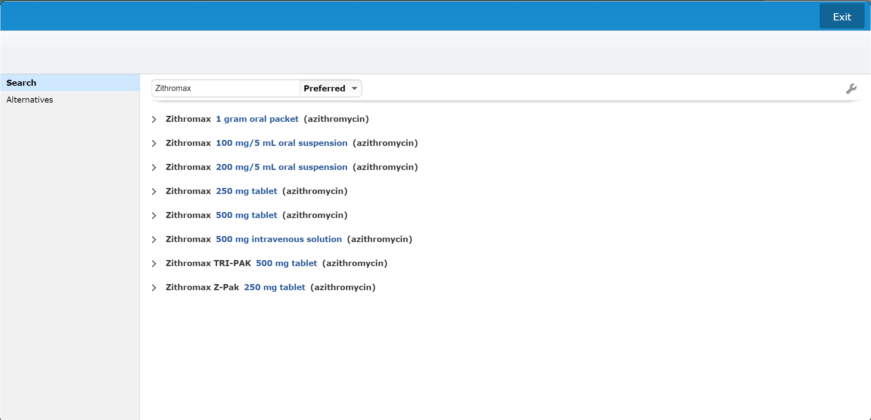
Universal Discharge Prescriptions
Searching for new medication
Select desired medication
Select the desired string (frequency/Duration)
Note that you can save as Favorite
Select the desire formulation
Selected string highlights in green
Click to Edit Rx
Queue & Exit if done
Queue if adding additional Rx’s
Exit if you want to cancel adding a RX
Pop-Up about Insurance recommendations – Click “OK”

Slide 27
Universal Discharge Prescriptions
Finalizing the Discharge Med Rec
Conflicts are indicated
Click “Submit” to finish

Slide 28
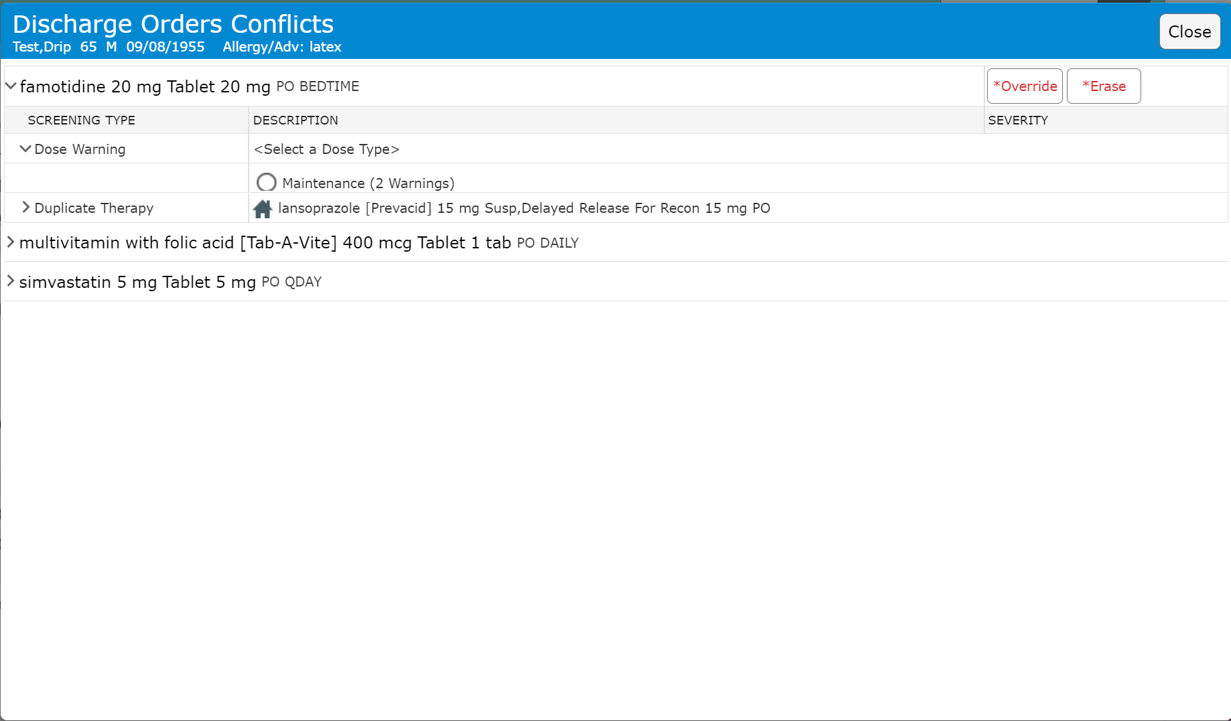
Universal Discharge Prescriptions
Conflicts
Pop-up one at a time
Override (may require a reason)
Erase (to remove med)

Slide 29
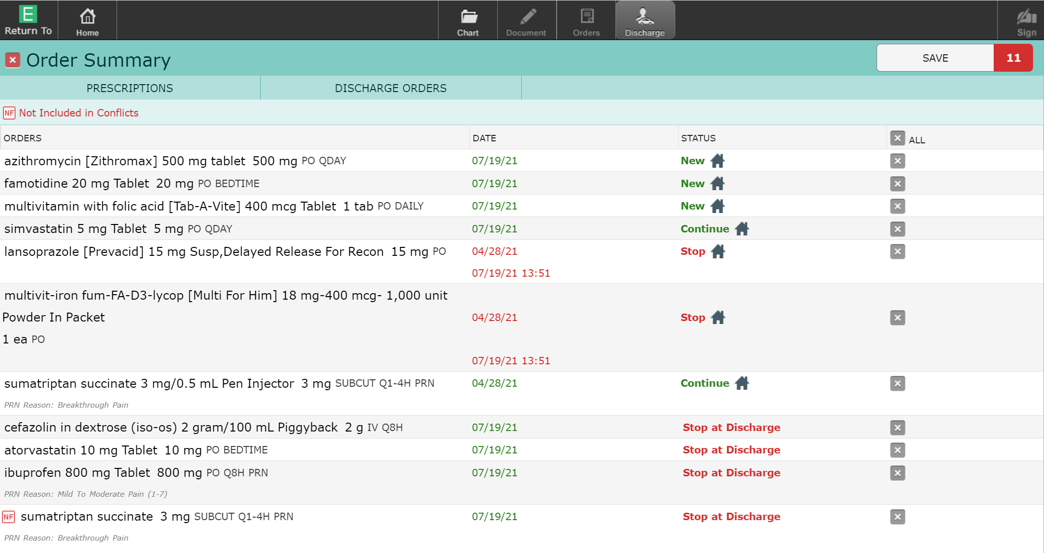
Universal Discharge Prescriptions
“Save” & PIN to complete process
Transmit/Print for Rx
Cancel if you change your mind
Becomes unreconciled

Slide 30
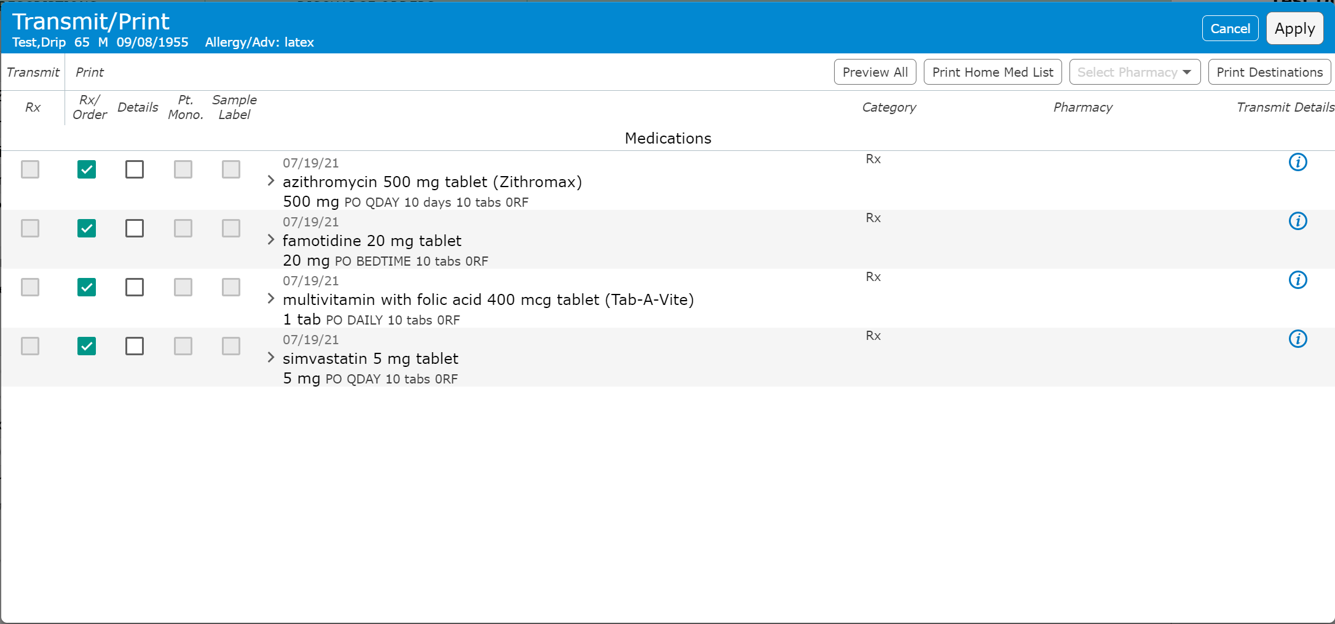
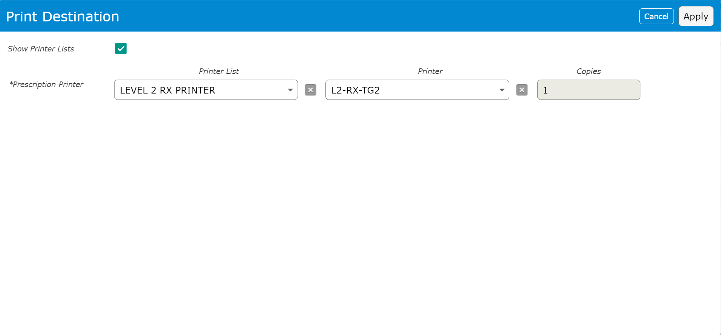
Universal Discharge Prescriptions
Transmit/Print screen
Print option
May default – depends on setup (eRx)
All options only show if no box is checked for Med
Transmit option
eRx must be setup to work
Preferred Pharmacy must be entered to work
Change Pharmacy
Confirm Printer
All Prescription Printers
List option
Unit and “TG”
In name of Rx printer

Slide 31
Universal Discharge Prescriptions
Final display of Prescriptions

Slide 32
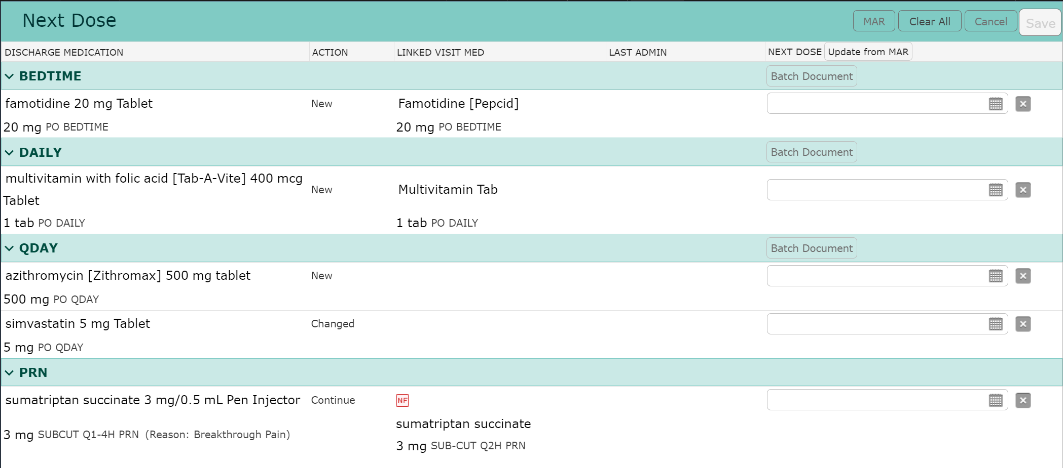
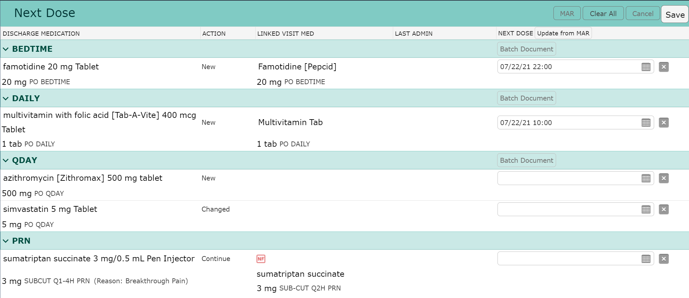
Universal Discharge Next Dose
Next Dose
Simply Click the NEXT DOSE “Update from MAR” button
The last previous administration date & time is applied
Click “Save”

Slide 33
Universal Discharge CRISP Questions
CRISP Questions
Required Yes or No, Were Opiate/Benzodiazepines prescribed on Discharge?
If Yes, The next question will become required in the future
Was CRISP accessed and the data reviewed?
If No, The next question will become required in the future
Exception reason
In our scenario, Opiates/Benzodiazepines were not prescribed
This example is provided for when CRISP was not consulted after Opiate/Benzodiazepine was ordered on discharge

Slide 34
Universal Discharge Required Section
These three questions are required
Functional capability
Functional capacity
Diet
Free text Additional Diet instructions

Slide 35
Universal Discharge Activity (required)
Activity
Activity is a required question
Additional activity instructions allow for more detail to be inserted

Slide 36
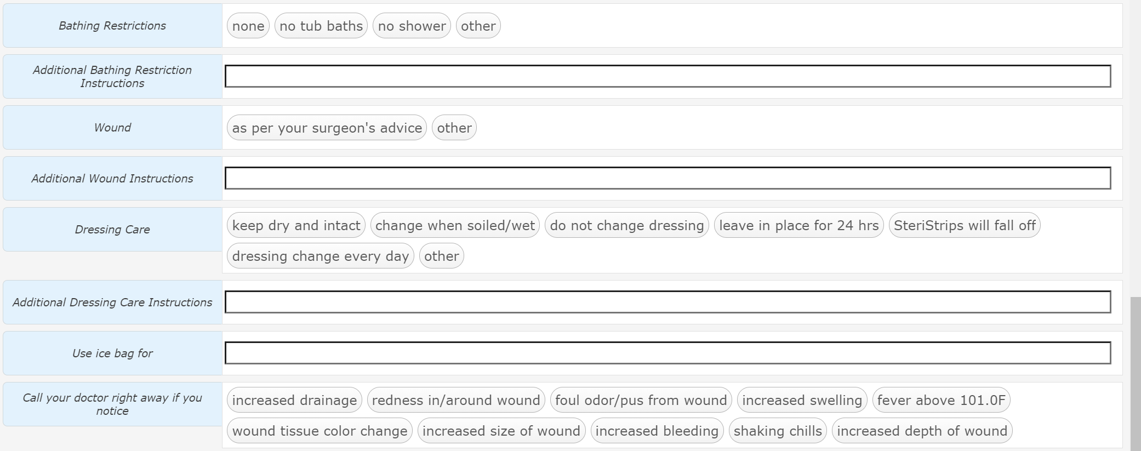
Universal Discharge Surgical Section
This surgical section allows for Post-Op care to be given with many free text options

Slide 37
Universal Discharge The Last Instructions
This section has the last areas for instructions
Additional Patient Instructions – ANY instructions not covered elsewhere
Forms – we aren’t using this on inpatient side
Instructions – Canned text instructions (Discussed next slide)
Print Language – ONLY the canned text (English/Spanish)
Total Time – Required – May affect billing (service dependent)

Slide 38
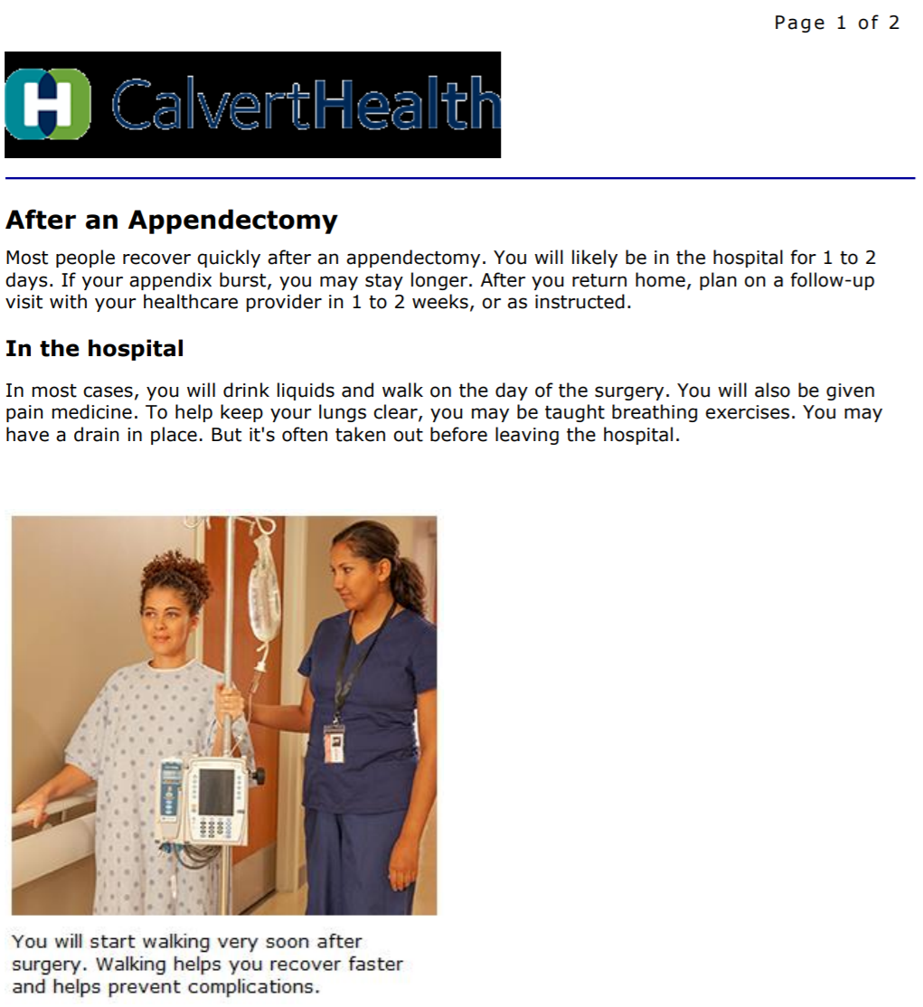
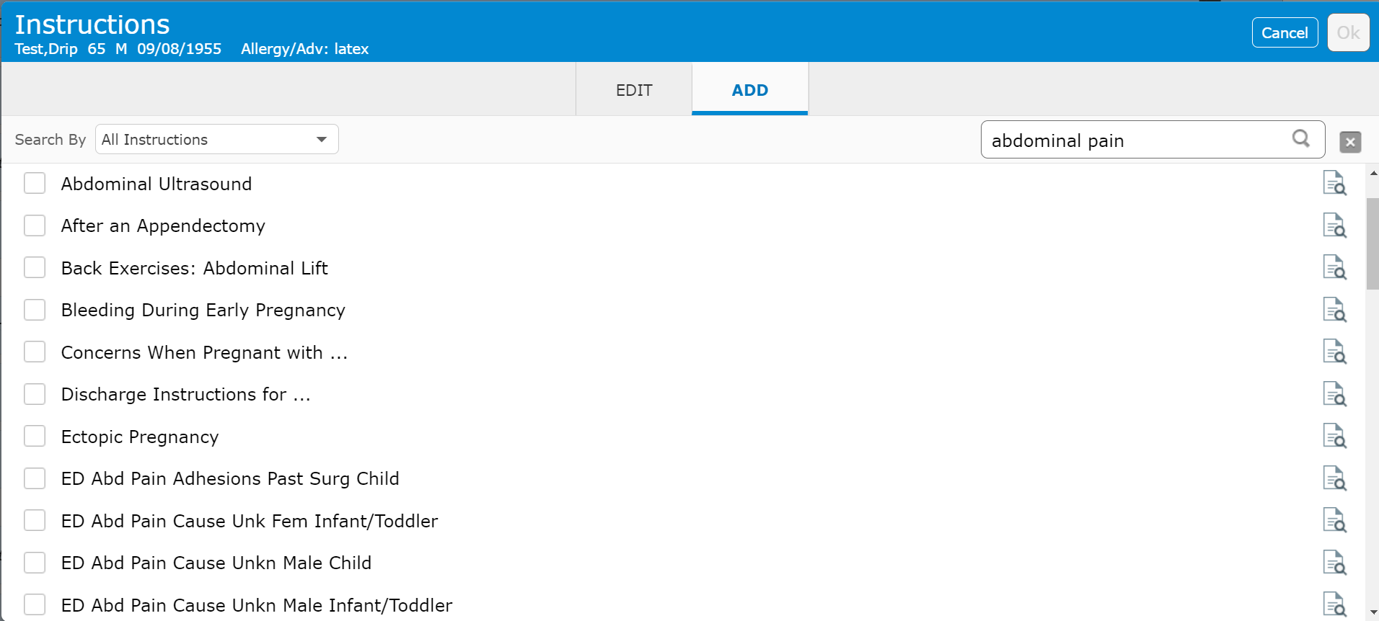
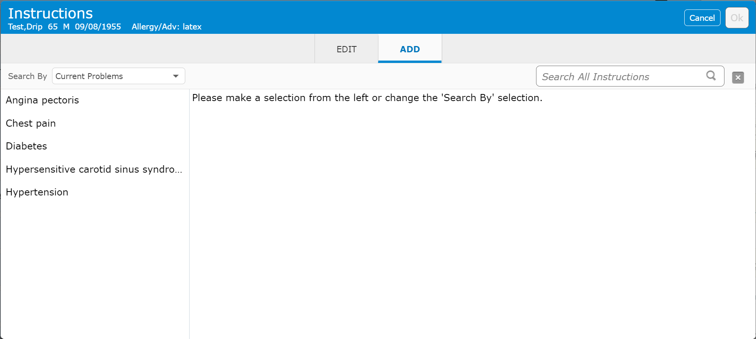
Universal Discharge Canned Text Instructions
Instructions
Search by diagnosis/key word
Available instructions are listed
Scroll for additional options
Click icon to view instructions (recommended prior to selecting first time)
Click box to select
OK to add when done
Current Problems may be selected from
This process doesn’t seem to work properly yet
Additional Instructions may be search for
This is a cropped screen shot of part of page 1 for “After an Appendectomy”

Slide 39
Universal Discharge
This section is reserved for future functionality
Ignore this section until instructed to use

Slide 40
Universal Discharge Discharge Order
Discharge Order
Click either area to access order
The Discharge Order
Date/Time can be changed if initiated prior to anticipated Discharge time
Required “Yes/No” to conditional
Conditional Criteria required IF “Yes” – Free text
**Must be assessable by Nurse**
Will trigger a nursing documentation reflex order

Slide 41
Universal Discharge Summary
We have reviewed the Inpatient Universal Discharge
This is the longest and most complex Discharge
SDS Discharge instructions are more focused and a subset of the Inpatient Universal Discharge

Slide 42
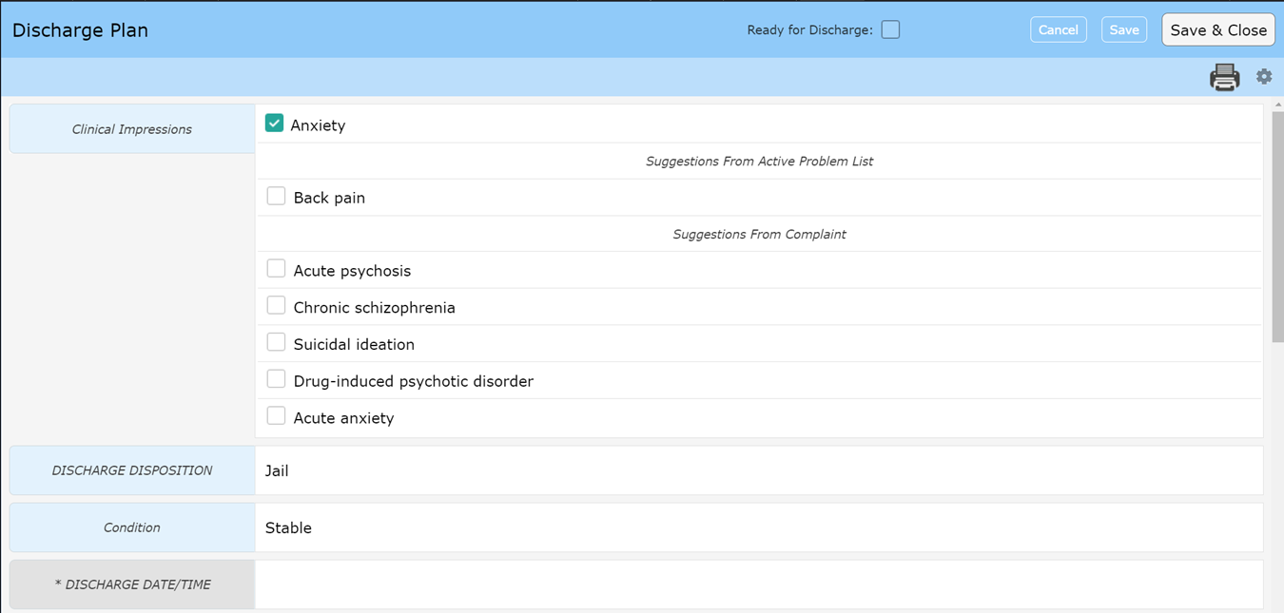
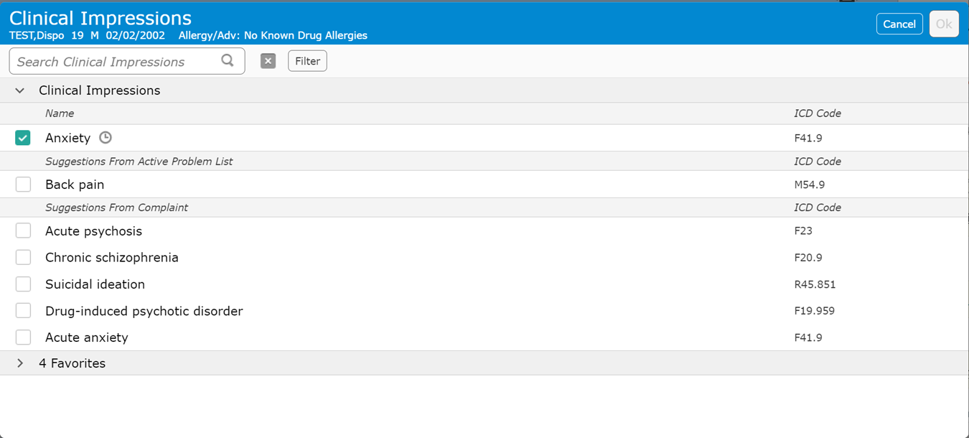
Universal Discharge ED
Ready for Discharge – Flags the nurse
Specificity may need to be added to generate an ICD-10 Code
Clinical Impression
Click on Blue area to search for alternatives

Slide 43
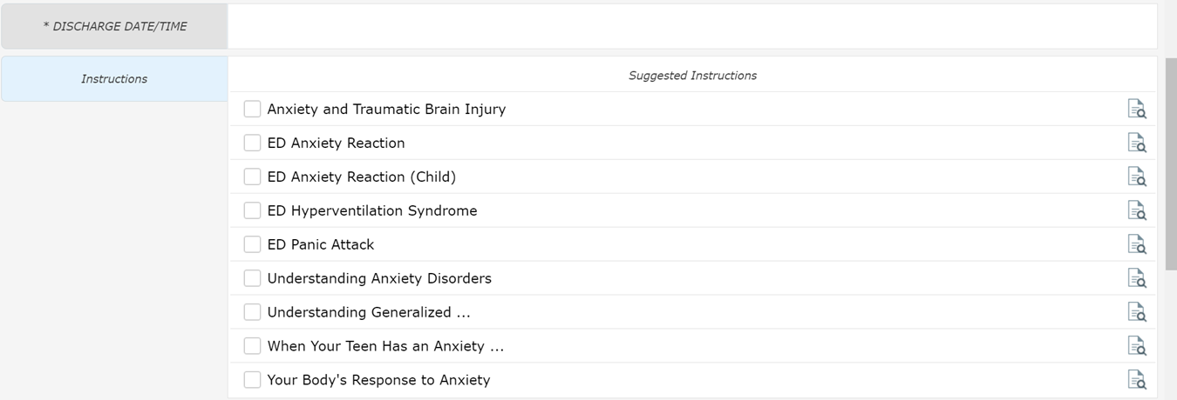
Universal Discharge ED
Discharge Date/Time
Nursing function – This field actually discharges the patient
Instructions
Suggestions if recommended Clinical Impression selected
Clicking anywhere in this area will allow you to search for additional instructions

Slide 44
Universal Discharge ED
This section has the same functionality as discussed previously
The order may be different

Slide 45
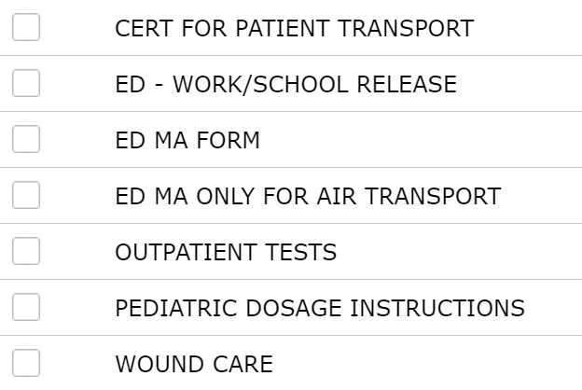
Universal Discharge ED
The ED – Work/School Release form is visible but others are available
Transfer to – Hospital list
May have to search by name due to list size
This is a shared field which causes issues when multiple providers are signing Doc
Reason for Transfer – justification for transfer
Accepting provider – Receiving facility

Slide 46
Thank You
You should have been scheduled for 1 on 1 training
Please call (410)535-8260 or email glenn.heaney@calverthealthmed.org if you have questions

